Slide 1

End-to-End VM Connectivity Across Subnets Using sshuttle, WireGuard, and Static Routing
Presented by Visesh Bentula

Slide 2
What is sshuttle?
sshuttle is a user-space VPN-like tool that forwards TCP traffic over an existing SSH connection.
It works by intercepting traffic on one node and tunneling it transparently through another node.
Advantages: quick setup, no need for root-level routing changes, useful for debugging or bypassing firewall restrictions.
Limitation: only supports TCP traffic; does not handle UDP or ICMP packets (e.g., ping).
Conceptually, sshuttle is a lightweight alternative to static routing or VPNs.
01

Slide 3
What is WireGuard?
WireGuard is a modern, high-performance VPN protocol designed to be simple yet highly secure.
It creates an encrypted point-to-point tunnel using a small set of cryptographic primitives.
Advantages:
Strong encryption with minimal overhead
Supports all traffic types (TCP, UDP, ICMP)
Faster and easier to configure compared to traditional VPNs
WireGuard is widely used in production networks and is well-suited for research testbeds like FABRIC.
02

Slide 4
What is Static Routing?
Static routing is the manual configuration of network paths using commands like ip route.
Each node is explicitly told which gateway to use to reach another subnet.
Advantages: full control, transparency, works for all protocols without tunneling overhead.
Limitations:
Not encrypted (unlike WireGuard)
Inflexible, any change in the network requires manual updates.
Conceptually, static routing is like a hard-coded map that ensures traffic flows in a predictable way
03

Slide 5
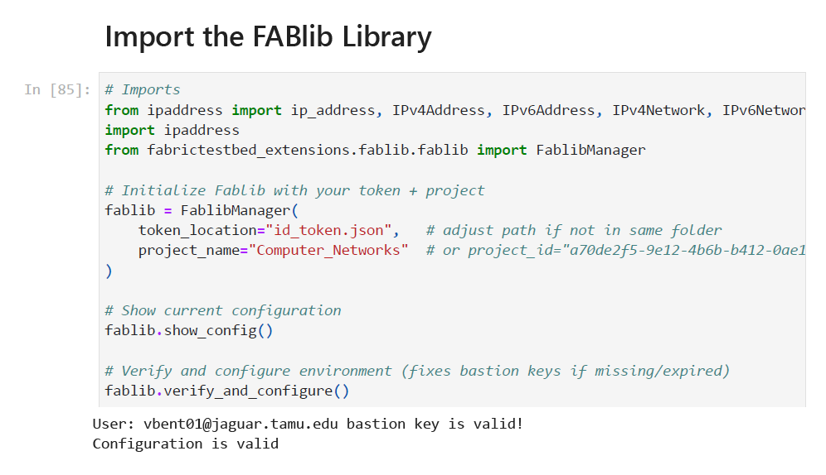
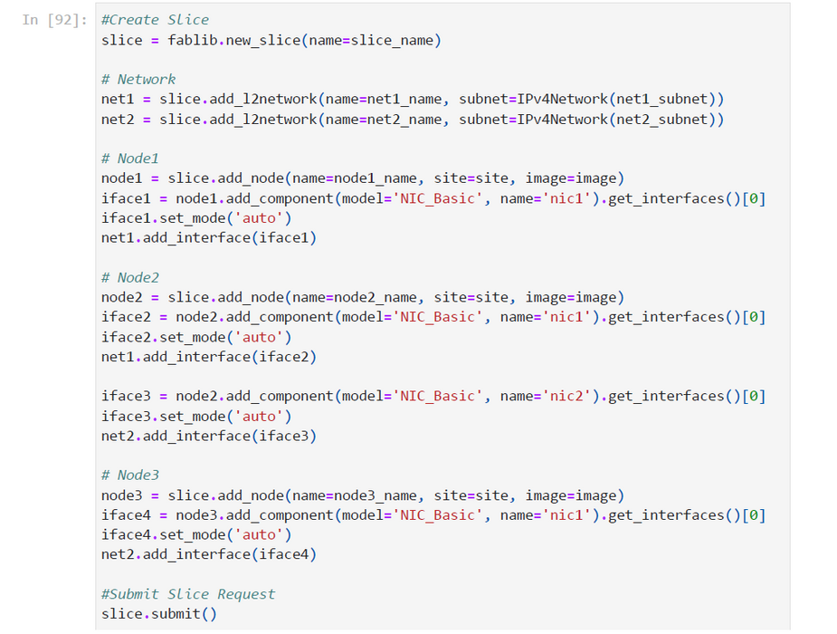
04
FABRIC Setup (Token & Slice Creation)
Token = authentication key, Slice = mini network lab
01
02
After completing the setup, I proceeded by following the research methodology and step-by-step process outlined in the project artifacts
Thynk Unlimited
-
Project
-
Presentation 2024

Slide 6
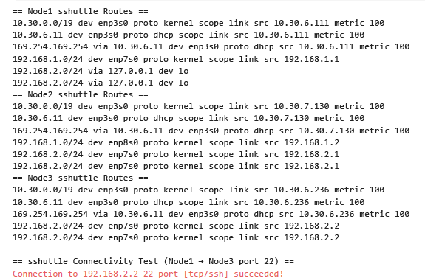
sshuttle Results
What Worked:
sshuttle created an SSH-based tunnel through Node2
A dummy route allowed Node1 to reach Node3’s subnet
Node1 successfully connected to Node3 (TCP port 22)
Routing table showed traffic for 192.168.2.0/24 redirected via 127.0.0.1
What Failed / Limitation
sshuttle only supports TCP traffic
Does not handle ICMP (ping) or UDP
Conclusion:
sshuttle provided quick TCP connectivity with minimal setup
Best suited for debugging or temporary access, not full connectivity
05

Slide 7
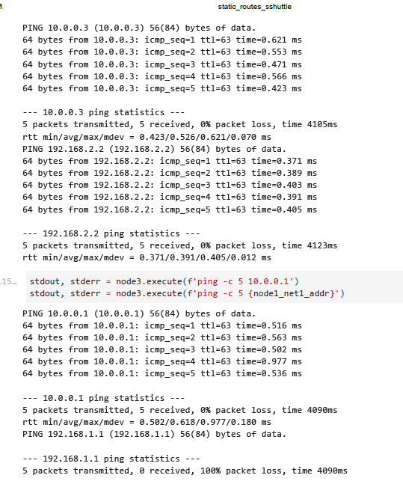

WireGuard Results
What Worked:
Node1 ↔ Node3 tunnel communication (10.0.0.x) successful
Node1 reached Node3’s underlay (192.168.2.2)
TCP test confirmed SSH connectivity on port 22
What Failed (100% Packet Loss):
Node3 could not ping Node1’s underlay (192.168.1.1)
Cause: WireGuard only forwards traffic defined in AllowedIPs
Node2 lacked forwarding/NAT rules to bridge overlay → underlay
Conclusion:
The packet loss is expected, not an error in WireGuard
To fix: enable forwarding/NAT on Node2 to allow overlay traffic to reach underlay IPs
06

Slide 8
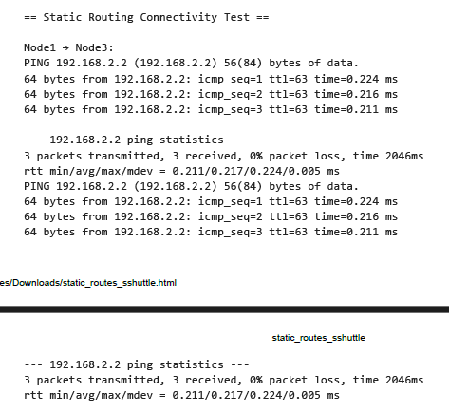
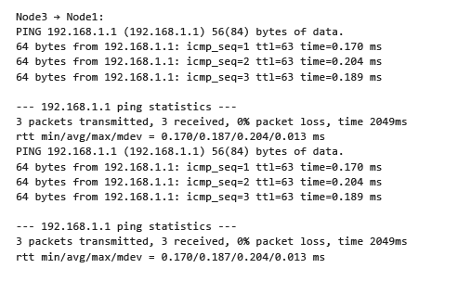
Static Results
What Worked
WireGuard and sshuttle were stopped to avoid interference
Node2 was configured with IP forwarding, acting as a router
Static routes set via Node2’s interfaces:
Node1 → Node3 via 192.168.1.2 (Node2)
Node3 → Node1 via 192.168.2.1 (Node2)
Ping confirmed connectivity between Node1 (192.168.1.1) ↔ Node3 (192.168.2.2)
Routing tables showed correct static entries pointing to Node2
What Failed / Limitation:
No encryption — traffic flows in plain text
Routes must be updated manually if the network changes
Conclusion:
Static routing delivered reliable end-to-end connectivity through Node2
Useful for learning and controlled experiments, but less secure and flexible than WireGuard
07

Slide 9
Thynk Unlimited
-
Project
-
Presentation 2024
Thank You

